Slide 1
Week 6: Web Security & Vulnerability Testing (VAPT Basics)
Task 1: Study OWASP Top 10
Broken Access Control - Maintaining its position at #1 in the Top Ten, 100% of the applications tested were found to have some form of broken access control.
Security Misconfiguration - Moving up from #5 in the previous edition, 100% of the applications tested were found to have some form of misconfiguration, with an
average incidence rate of 3.00%, and over 719k occurrences of a Common Weakness Enumeration (CWE) in this risk category.
Software Supply Chain Failures - This was top-ranked in the Top 10 community survey with exactly 50% respondents ranking it #1.
Cryptographic Failures - Sensitive information is inadequately protected through encryption or other cryptographic controls.
Injection - Untrusted input is interpreted as commands or queries, as in SQL Injection.
Insecure Design - Security weaknesses arise from missing or ineffective security controls in the application's design.
Authentication Failures - Weak identity verification or session handling allows unauthorized access.
Software or Data Integrity Failures - Software updates, code, or data are not adequately verified for integrity.
Security Logging and Alerting Failures - Security events are not properly recorded, monitored, or alerted on.
Mishandling of Exceptional Conditions - Errors and unusual conditions are handled insecurely, potentially creating vulnerabilities.

Slide 2
SQL Injection (SQLi) - SQL Injection occurs when an application handles user input unsafely, allowing it to alter database queries.
Example: A vulnerable login page may allow specially crafted input to change the logic of a database query.
Impact:
  Unauthorized database access.
  Exposure of sensitive information.
  Modification or deletion of records.
  Potential authentication bypass.
Prevention:
  Use parameterized queries and prepared statements.
  Validate input appropriately.
  Apply least-privilege database permissions.
  Avoid exposing detailed database errors.
Cross-Site Scripting (XSS) - XSS occurs when a website allows untrusted content to execute as code in another user's browser.
Types:
Stored XSS: Malicious content is stored by the application and displayed to users.
Reflected XSS: Malicious input is included in an immediate response.
DOM-based XSS: Unsafe client-side JavaScript processes untrusted data.
Impact:
  Manipulation of web page content.
  Phishing attacks.
  Unauthorized actions within a user's browser.
  Exposure of information accessible to malicious scripts.
Prevention:
  Apply context-aware output encoding.
  Use safe DOM manipulation.
  Validate input.

Slide 3
Implement a suitable Content Security Policy (CSP).
C. Broken Authentication - Authentication failures occur when an application does not adequately verify user identities or securely manage authenticated sessions.
Examples:
Weak password policies.
Unlimited login attempts.
Impact:
Unauthorized access.
Exposure of confidential information.
Prevention:
Implement multi-factor authentication.
Use secure password-hashing algorithms.
Apply login rate limiting.
D. Security Misconfiguration - Security misconfiguration occurs when an application, server, database, or cloud service is configured insecurely.
Examples:
Default credentials remain unchanged.
Unnecessary services are enabled.
Impact:
Unauthorized access.
Data exposure.
Increased attack surface.
Prevention:
Change default credentials.
Disable unnecessary services.
Apply security patches.

Slide 4
Task 2: Install & Setup Tools
Burp Suite (Community Edition):
  Open the kali terminal and run: sudo apt update
  Sudo apt install burpsuite -y
  Then launch it: burpsuite
Install OWASP ZAP on Kali Linux:
  https://www.zaproxy.org/download/
Set up DVWA using Docker on Kali Linux
  In kali terminal: sudo apt update sudo apt install docker.io -y
  Then enable docker and check version: sudo systemctl enable --now docker
docker –version
  We install Docker Compose because DVWA needs multiple services to run together: the DVWA web application and its database. To install it:
  sudo apt install docker-compose
  Then start DVWA: cd ~/Desktop
git clone https://github.com/digininja/DVWA.git cd DVWA
  Then start the application: sudo docker-compose up -d
  Check the containers: sudo docker-compose ps
  Open DVWA
Open Firefox and visit: http://localhost:4280

Slide 5
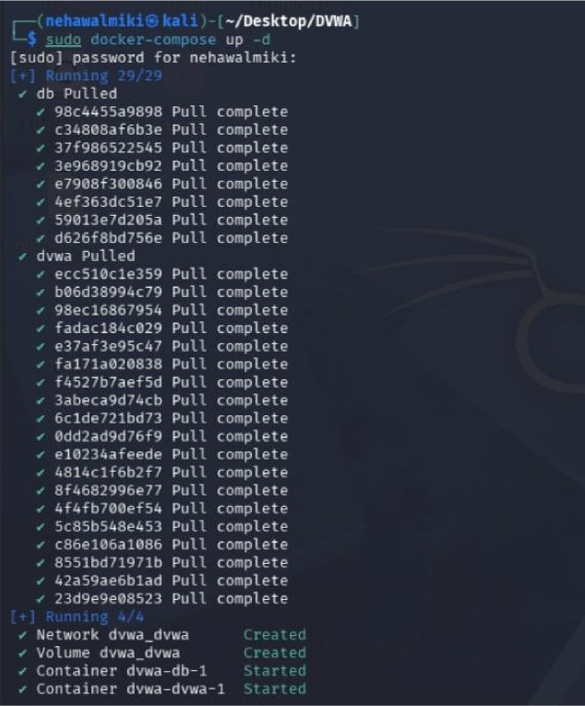
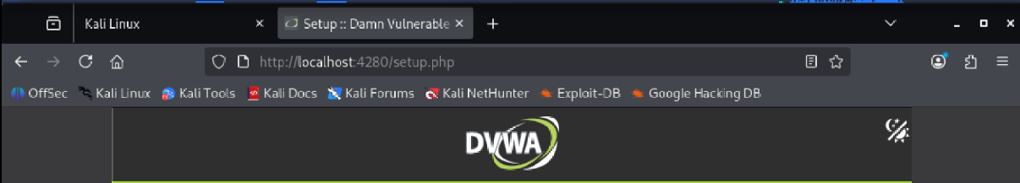




Database Setup
lf you get an error mmc sure you have ite correct user credentials in: Rarfwwwfhtml/conti9feorifig.inc.php
ir the dataase already exists. it will be ciearwi ana be data will be reset.
You can also use this la reset rhe administrator credentials aamin // pasword g ai any stage.
Setup Check
Operaing synem:*nix
reCAPTCHAkey: Missing
mod rewrite is required for the API labs.

Slide 6
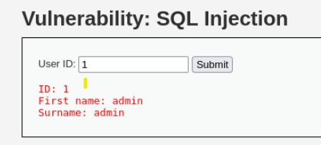
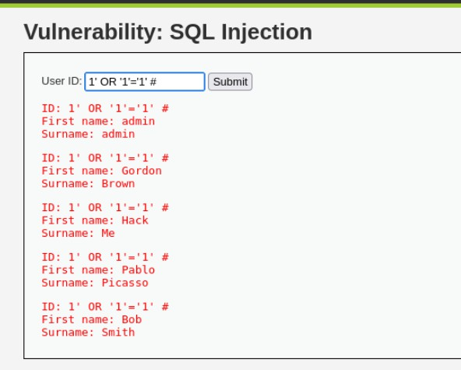
Task 3: Perform Testing (DVWA)
Test SQL Injection
Enter a normal value
Test a basic SQL injection condition in the local lab by entering:
Result: The SQL injection test was successful. Normally, entering user ID 1 should display only one user's details. However, the injected condition ' OR '1'='1' is always true, causing the application to display multiple user records. The # symbol comments out the remaining SQL query in MySQL. This shows that the application does not safely handle user input.

Slide 7
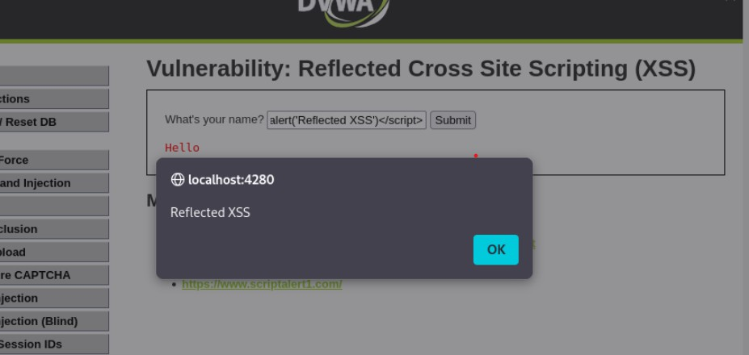
Test XSS (Stored & Reflected)
Open XSS (Reflected) from the DVWA menu.
Enter <script>alert('Reflected XSS')</script> and submit
Check whether the value appears in the response page.
Browser alert dialogue box successfully generated from localhost:4280 displaying the string "Reflected XSS". This confirms the presence of a high-severity flaw.
Test Stored XSS
Open XSS (Stored) from the DVWA menu.
Enter a name such as labuser.
Enter <script>alert('Stored XSS')</script> and submit
Verify that the message appears in the guestbook or message list.

Slide 8
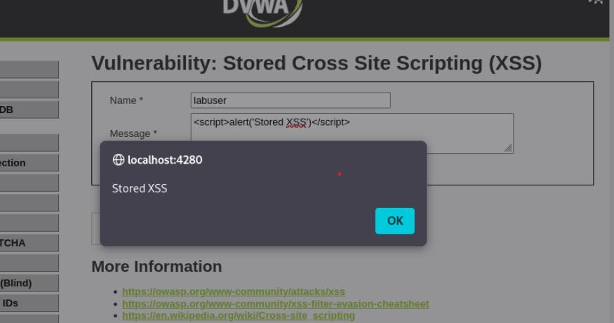
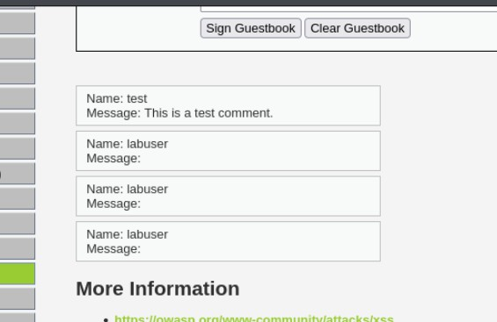
When I click the button to submit, the website saves this code directly into its database. Because the website doesn't clean the text, it immediately runs the code, popping up the grey box that says "Stored XSS".
The text isn't actually missing. The text is the hidden code. Every single time this page loads, the web browser reads that hidden code and executes it behind the scenes instead of displaying it as text.

Slide 9
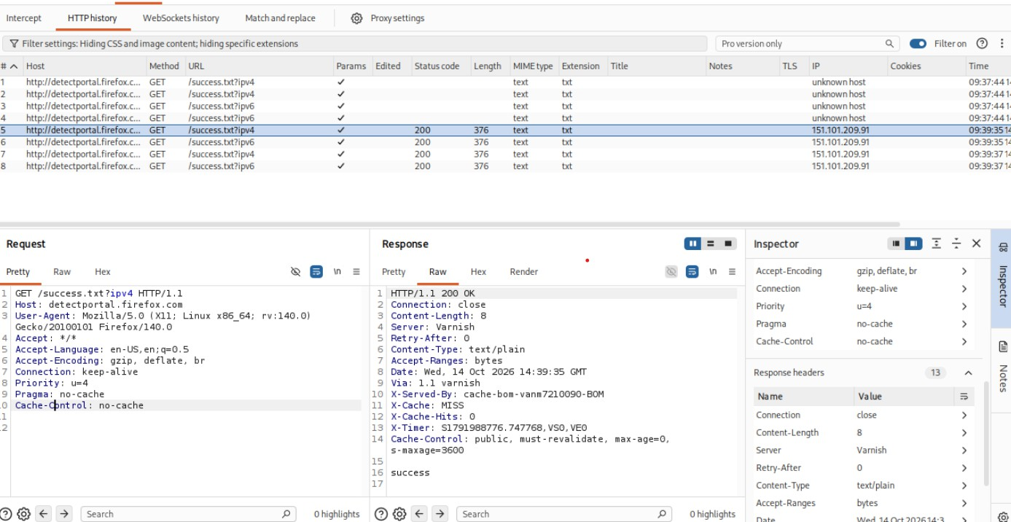
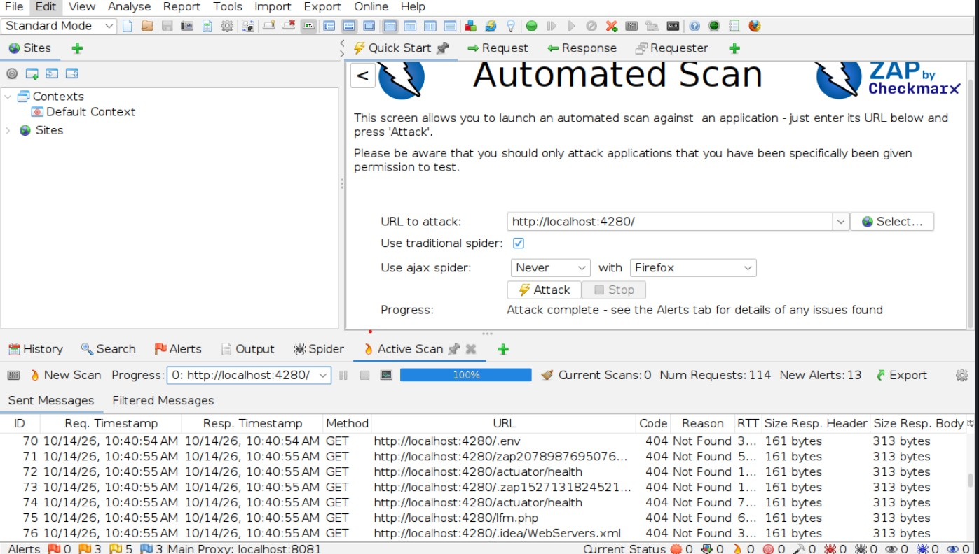
Task 4: Scan Using OWASP ZAP
On the Quick Start tab, click Automated Scan.
In the URL to attack field, enter: http://localhost:4280/
Click Attack and wait for ZAP to finish crawling and scanning the site.

Slide 10
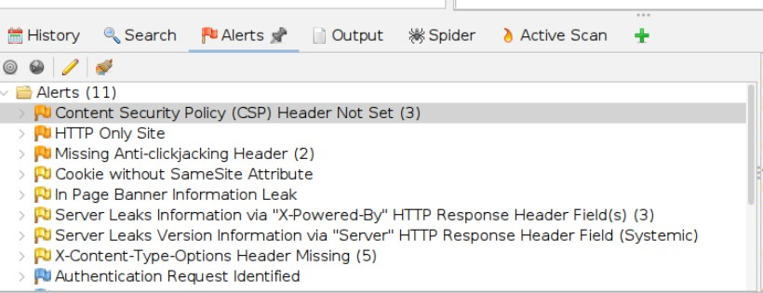
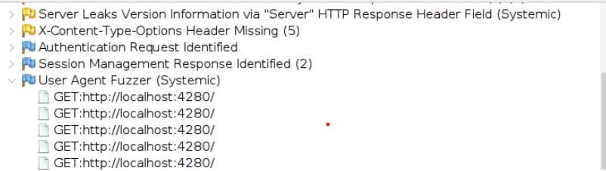
In total, ZAP sent 114 requests and flagged 13 vulnerabilities
Medium Risk Alerts
  HTTP Only Site: The application runs over unencrypted HTTP instead of secure HTTPS. All data passed between the user and the application—including passwords and session tokens—is vulnerable to interception via Man-in-the-Middle (MitM) attacks.
  Missing Anti-clickjacking Header (2 instances): The server lacks X-Frame-Options or CSP frame-ancestor’s directives. This allows malicious sites to load your application inside an invisible <iframe>, tricking users into clicking buttons they did not intend to click.
Low Risk Alerts
  In Page Banner Information Leak: The application exposes software, system version names, or engineering details directly inside the visible HTML source code, assisting attackers with targeted recon.

Slide 11
Task 5: Project Report
Introduction to VAPT
Vulnerability Assessment and Penetration Testing (VAPT) is a cybersecurity process used to identify, evaluate, and validate security weaknesses in systems, networks, and applications.
Tools used
DVWA
Damn Vulnerable Web Application is an intentionally insecure web application used for learning web application security testing.
XAMPP
XAMPP is a local development environment that includes components such as Apache, MariaDB, PHP, and Perl.
Apache serves the web application, PHP executes application code, and the database stores application data.
Burp Suite Community Edition
Burp Suite is a web application security testing tool. Its proxy functionality allows a tester to inspect HTTP requests and responses between a browser and a web application.
OWASP ZAP
OWASP Zed Attack Proxy (ZAP) is an open-source web application security testing tool.
Kali Linux
Kali Linux is a Linux distribution designed for penetration testing and security assessments. It provides a platform for running security tools, including OWASP ZAP.
Testing process
SQL Injection Test -
Testing Procedure
Open DVWA and log in.
Navigate to the SQL Injection module.
Enter a normal test value and record the expected result.
Enter a controlled SQL Injection test input.

Slide 12
Submit the input.
Compare the response with the normal request.
Capture the relevant request and response in Burp Suite.
Record the actual output and evidence.
Cross-Site Scripting Testing
Testing Procedure:
Open the Stored XSS module.
Submit a normal test value first.
In the authorized lab, enter the same harmless proof-of-concept if the module permits it.
Submit the input.
Reload or revisit the page.
Observe whether the content persists and executes.
Capture the submission and subsequent page response.
OWASP ZAP Automated Scan
Testing Procedure:
Launch OWASP ZAP in Kali Linux.
Select Quick Start.
Open Automated Scan.
Enter the DVWA URL.
Click Attack.
Allow ZAP to discover and test accessible pages.
Review the Alerts tab.
Inspect alert evidence and risk levels.
Export the results in HTML format.
  Findings & Risk Levels
We were able to find alerts using ZAP. Risk level was high, medium and low
  Mitigation methods
SQL Injection Mitigation
Recommended controls:
Use prepared statements and parameterized queries.
Avoid concatenating untrusted input into SQL commands.

Slide 13
XSS Mitigation
Recommended controls:
Use context-aware output encoding.
Use safe templating and DOM methods.
Authentication Mitigation Recommended controls include:
  Secure password hashing.
  Appropriate multi-factor authentication.

